Slide 1
Global Imbalances and the Core-Periphery Model
An EU perspective
Marie Püts and Elia Di Gregorio

Slide 2
Structure
Introduction
Literature review
Dataset
Focus: EU 2016/2022
Cluster Analysis
Implication for Cohesion Policy
Contestualization Homeland Economics
Discussion

Slide 3
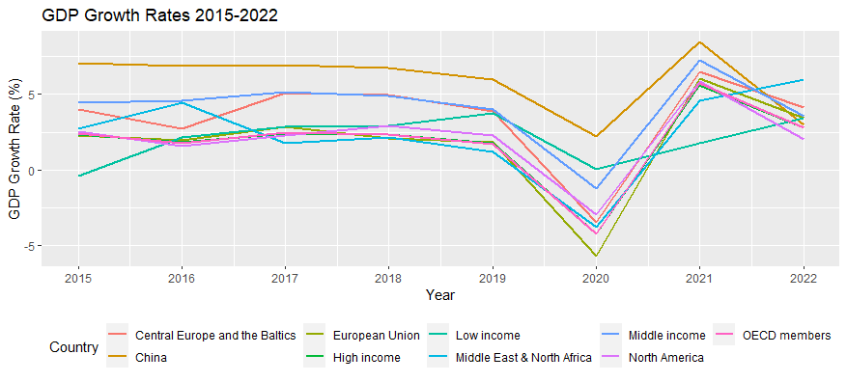

Slide 4
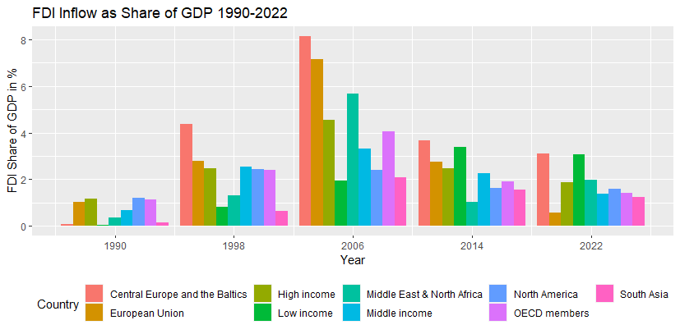

Slide 5
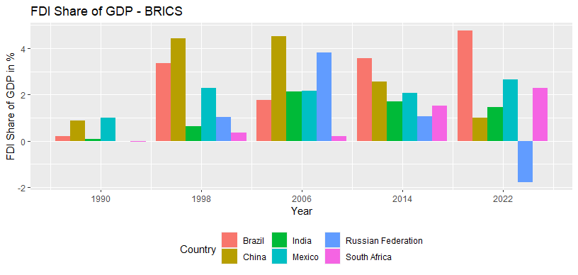

Slide 6
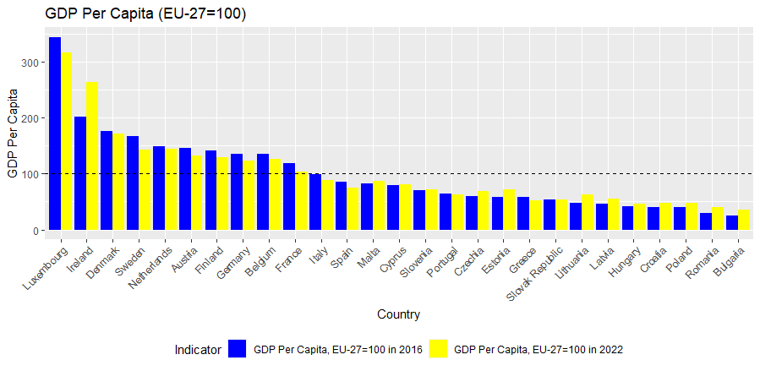

Slide 7
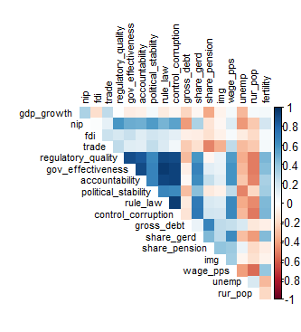
Cluster Analysis - Methodology

Slide 8
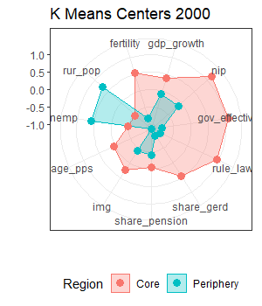
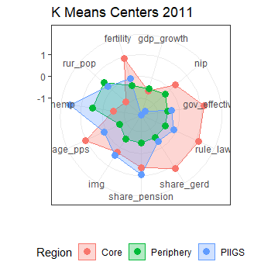
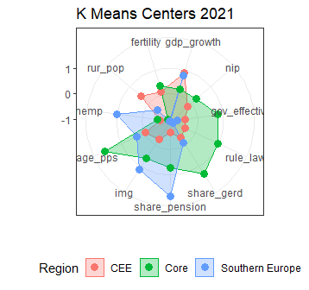
EU Core – Periphery through the years

Slide 9
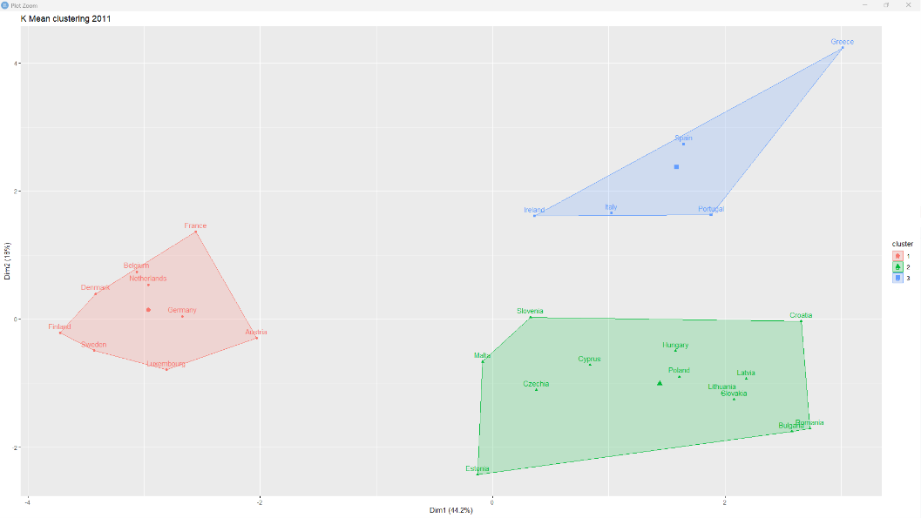
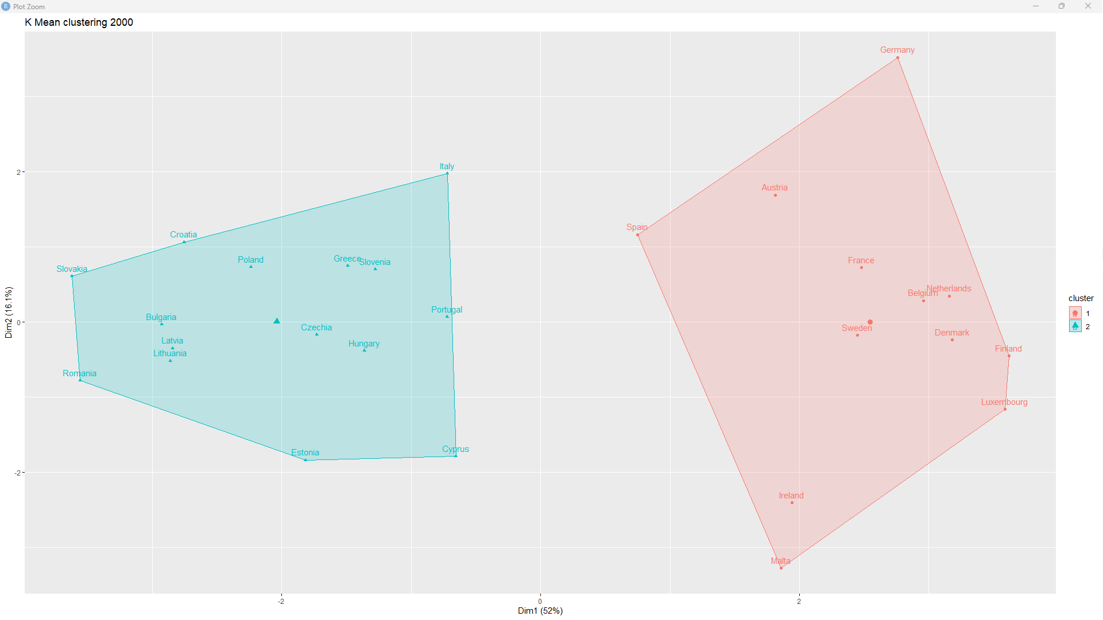
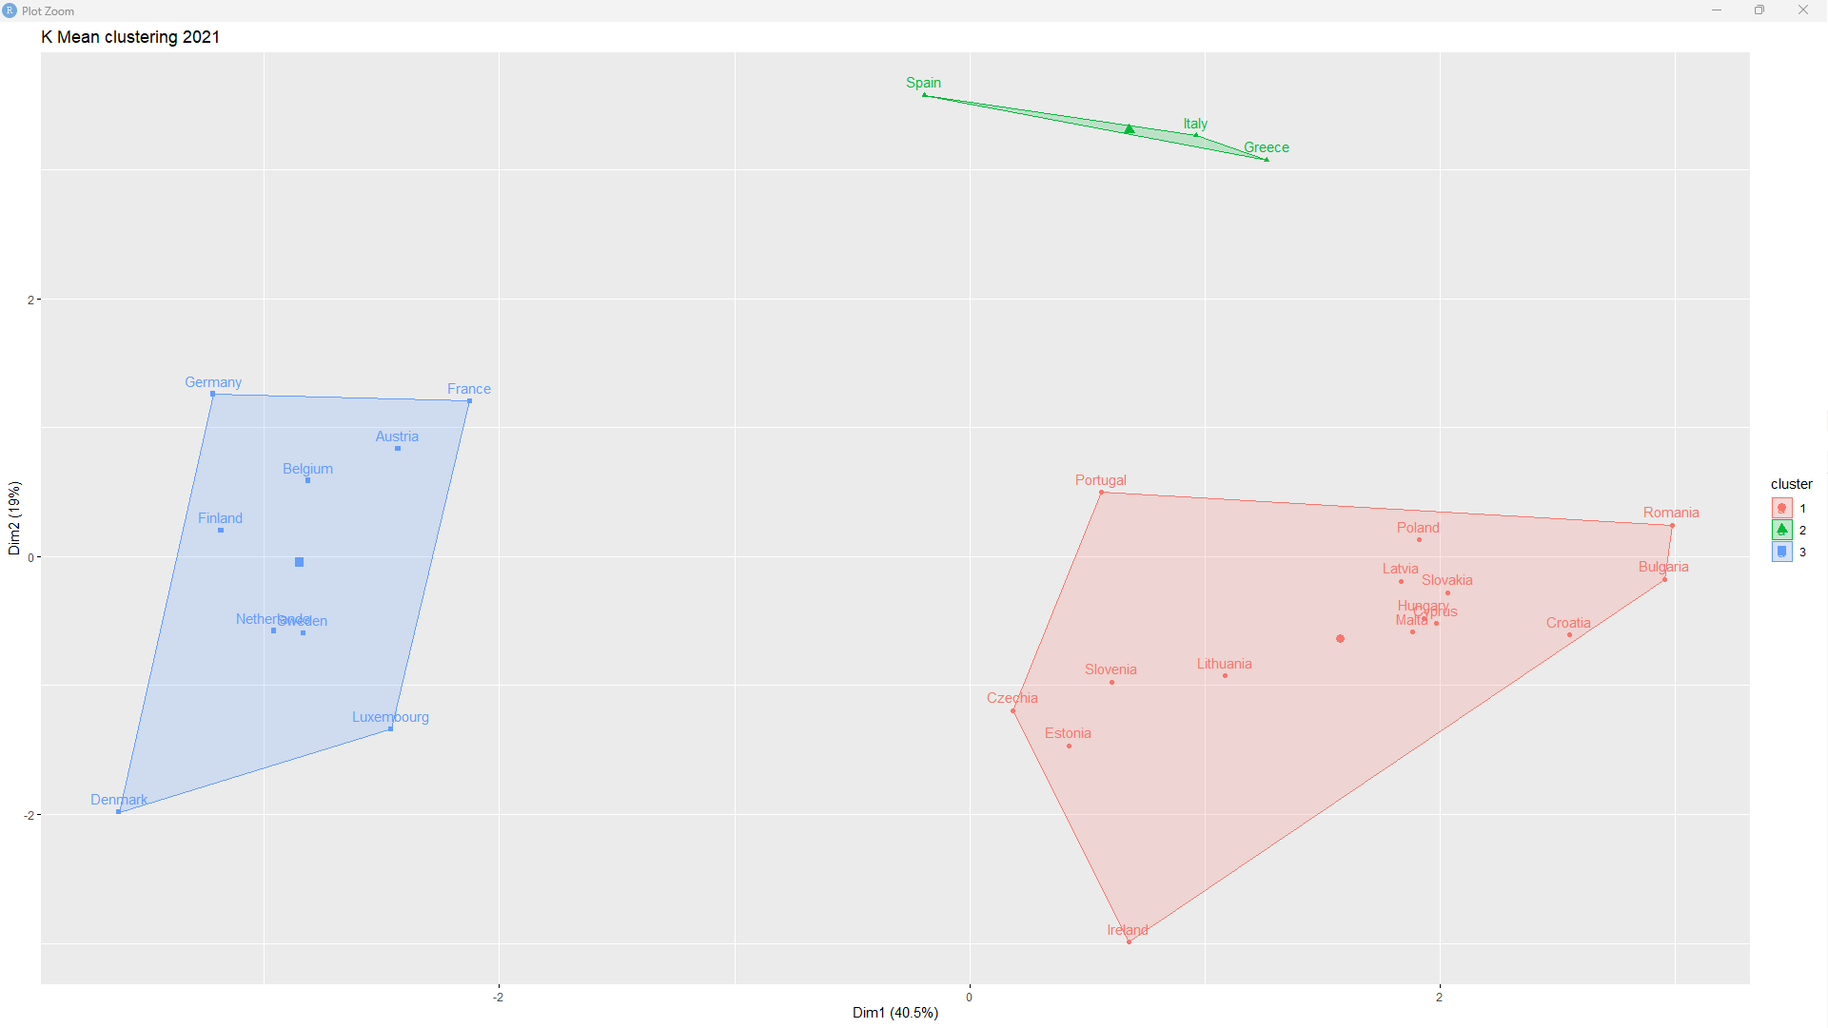
To include maybe

Slide 10
EU Cohesion Policy implications

Slide 11
A step further: deglobalization

Slide 12
Conclusion

Slide 13
References

Slide 14
Thanks you for the attention!

